Slide 1

DEPARTMENT OF COMPUTER SCIENCE & ENGINEERING
“TALK-LINE CHAT”
20CSE59
Presentation by,
NAME:K.SREEJA
USN:1NH18CS728
Under the Guidance of ,
Guide: Mrs.SUGANYA
Senior assistant professor

Slide 2
Agenda
Introduction
Problem definition
Objectives
Concepts implemented
Database diagram
Conclusion

Slide 3
INTRODUCTION
Python uses Tkinter (Tk=Tool kit; inter=interface) to create GUI (Graphical User Interface). GUI helps to create a display interface in windows which is being used to take input from users and displaying output. Inserting and accessing data is happening with the help of backend through SQLite3 connection.
Applications such as adding Group, Event and Post, showing details of all the members, projects and clients, sending and receiving messages, showing bar chart, etc. have been done in Python as a frontend which is processed in backend with the help of SQL in SQLite database.
The project contains entire information about the Group, Event, Post for each user. In the SQLite seven tables (User, Group, Event, Message, Post, Joins, Participate) have been created in the backend.

Slide 4
PROBLEM DEFINITION
Nowadays people are becoming socially active.
To make them interact with each other this project will help.
It helps in creating a group for users, event and also people can post.
It helps in online social networks by connecting a user’s profile with those of other individuals or groups.
Users can connect with their known ones.
Users can chat and interact with other users.
20/10/2020

Slide 5
OBJECTIVES
To learn how to build and package Python modules for reusability.
To learn how to design Object oriented programs.
To learn how to use class inheritance in Python for reusability.
To learn how to use exception handling in Python applications for error handling.
To make better understanding of lists, tuples, dictionaries in Python programs.
To understand why Python is a useful scripting language for developers.
To learn how to design and program Python applications.
20/10/2020

Slide 6
CONCEPTS IMPLEMENTED
FUNCTION
A function is a block of code which only runs when it is called.
We can pass data, known as parameters, into a function.
"def" is the keyword used to define a function.
A function can return the value

Slide 7
def my_function(): //creating a function
print ("Hello, I am block of function code") //block of code
my_function() //calling function.
SYNTAX FOR CREATING A FUNCTION

Slide 8
TKINTER
Tkinter is the standard GUI library for Python.
fast and easy way to create GUI applications.
It is a powerful object-oriented interface to the Tk GUI toolkit.
Import the Tkinter module.

Slide 9
FRAMEWORK WIDGET
Label - Display text on the screen
Button - Contain text and can perform an action when clicked
Entry - Allows only a single line of text
Text - Allows multiline text entry
Frame - rectangular region used to group related widgets or provide padding between widgets

Slide 10

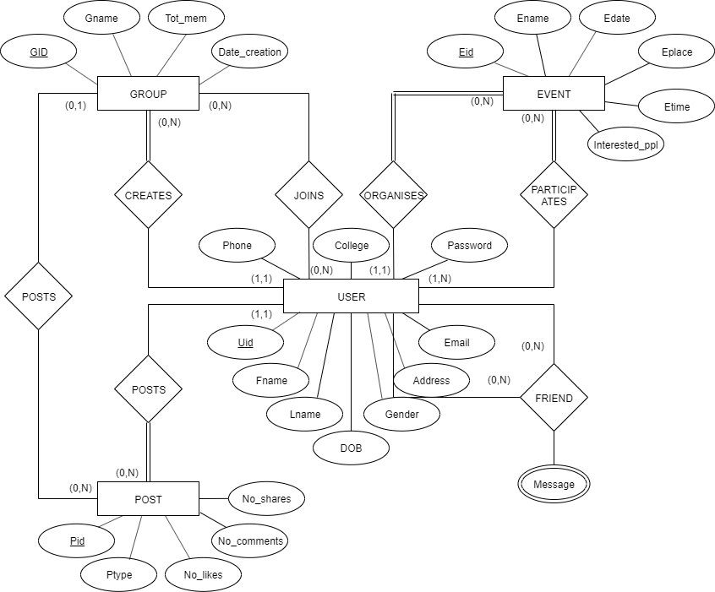
ER DIAGRAM
ER diagram of Talk-line Chat

Slide 11
Conclusion
The main objective behind creating Social Media application was to bring out changes in the social networking environment. Its aim is to make people spend time by connecting socially. Keeping the record of each users, posts, groups and events in database is more efficient as it helps us to preserve data for further help and it doesn’t consume a lot of time. Realizing all facts like digital recording of data, keeping track on the users, data visualization, sending event information to users, getting ping on friends birthdate, updating progress through any place would make this beautiful application very useful in corporate world.
Further adding new features to it will continue in the future.

Slide 12
THANK YOU

